Slide 1


Astro: A Zodiac Sign Predictor

Slide 2
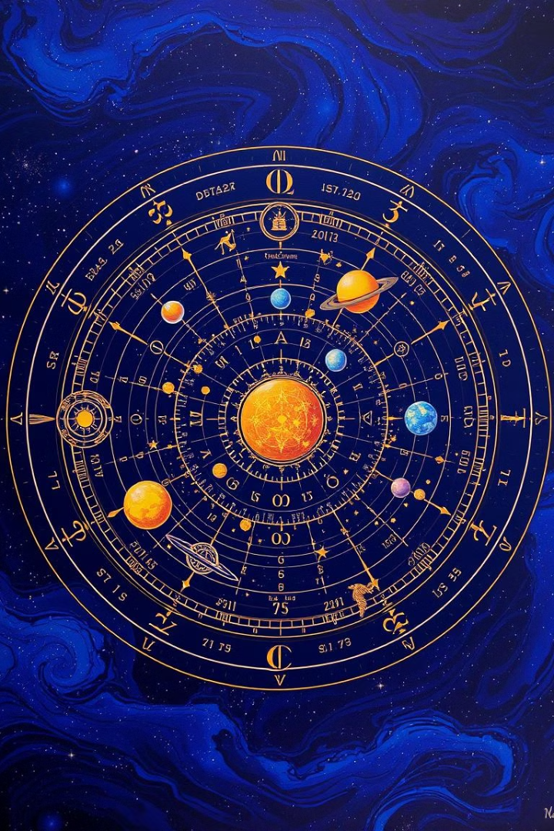
What is Astrology and Zodiac Signs?
Cosmic Influence
Zodiac Signs
Astrology studies the purported influence of celestial bodies on human affairs.
The Zodiac is divided into 12 signs, each associated with a specific constellation.
Birth Chart
A birth chart maps the positions of planets at a person's birth, used for astrological analysis.

Slide 3












The 12 Zodiac Signs
Aries
Taurus
Gemini
Cancer
March 21 - April 19
April 20 - May 20
May 21 - June 20
June 21 - July 22
Leo
Virgo
Libra
Scorpio
July 23 - August 22
August 23 - September 22
September 23 - October 22
October 23 - November 21
Sagittarius
Capricorn
Aquarius
Pisces
November 22 - December 21
December 22 - January 19
January 20 - February 18
February 19 - March 20

Slide 4
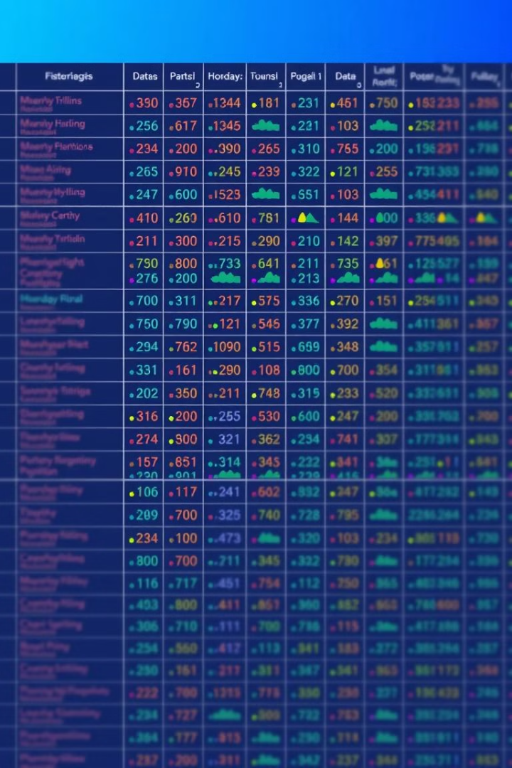
Data Collection and Preprocessing
1
Data Sources
We gathered data from various sources, including online databases and APIs.
2
Data Cleaning
We handled missing values, outliers, and inconsistencies in the data.
3
Feature Engineering
We transformed the data to create meaningful features for our model.

Slide 5



Machine Learning Model Development
Algorithms
1
We explored various algorithms, including decision trees and Random Forest Classifier.
Model Training
2
We trained the model using the prepared data to learn patterns.
Model Evaluation
3
We assessed the model's performance using accuracy and precision metrics.

Slide 6
Power BI Dashboard for Visualization
Data Visualization
1
We used Power BI to create interactive dashboards for visual analysis.
Key Metrics
2
The dashboard displayed key metrics such as accuracy and sign distribution.
Insights Discovery
3
Interactive elements enabled users to drill down into specific data points.

Slide 7
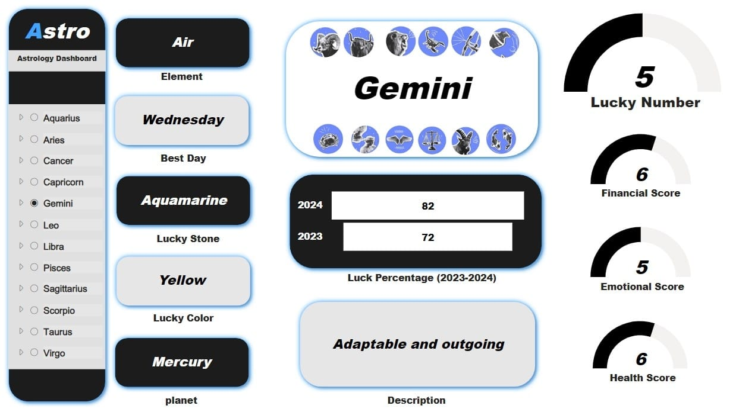

Slide 8












Project Outcomes and Key Insights
Our Astro project successfully predicted Zodiac signs with high accuracy, demonstrating the potential of Machine Learning for astrological insights. The Power BI dashboard provides a user-friendly interface for exploring the data and key findings.

Slide 9
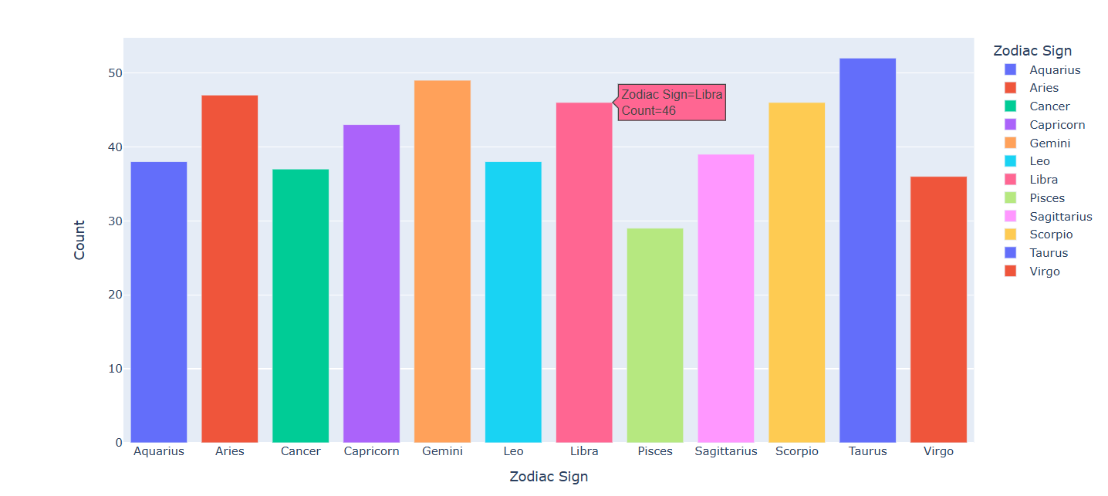


Slide 10
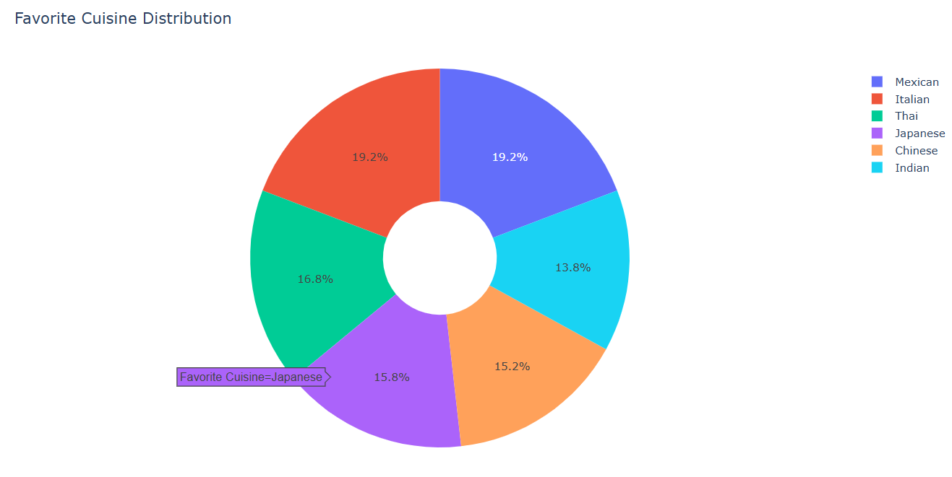

Slide 11
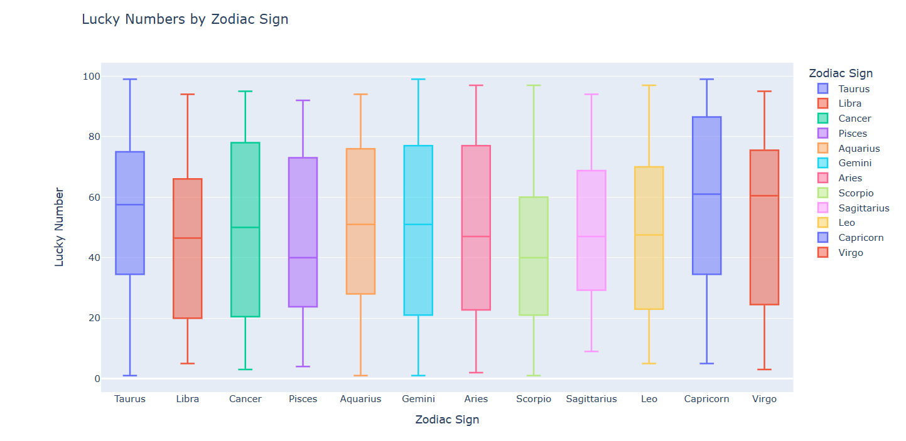

Slide 12
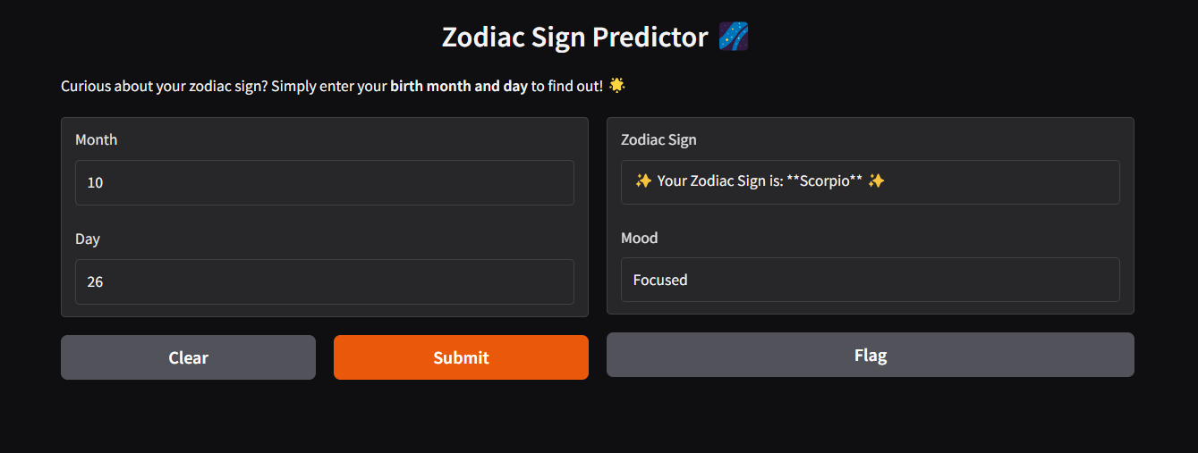
User Interface:

Slide 13

Project Challenges and Learnings
1
Data Quality
Ensuring accurate and consistent data was a significant challenge.
2
Model Selection
Choosing the right algorithm for optimal prediction was key.
3
Visualization Design
Creating an effective and insightful Power BI dashboard was crucial.

Slide 14
Thank You

